Slide 1
ENTERPRISE SYSTEMS ARCHITECTURE
CHAPTER 3
1
Copyright © 2012 Pearson Education, Inc. Publishing as Prentice Hall

Slide 2
Components of the Enterprise Systems Architecture
Functional
  Defines the ERP modules that support the various business functions of the organization. Examples include:
    Accounting
    Human Resources
    Procurement
    Fulfillment
    Etc.
System
  Defines the ERP architecture through the physical components of hardware, software, and networking angle.
Copyright © 2012 Pearson Education, Inc. Publishing as Prentice Hall

Slide 3
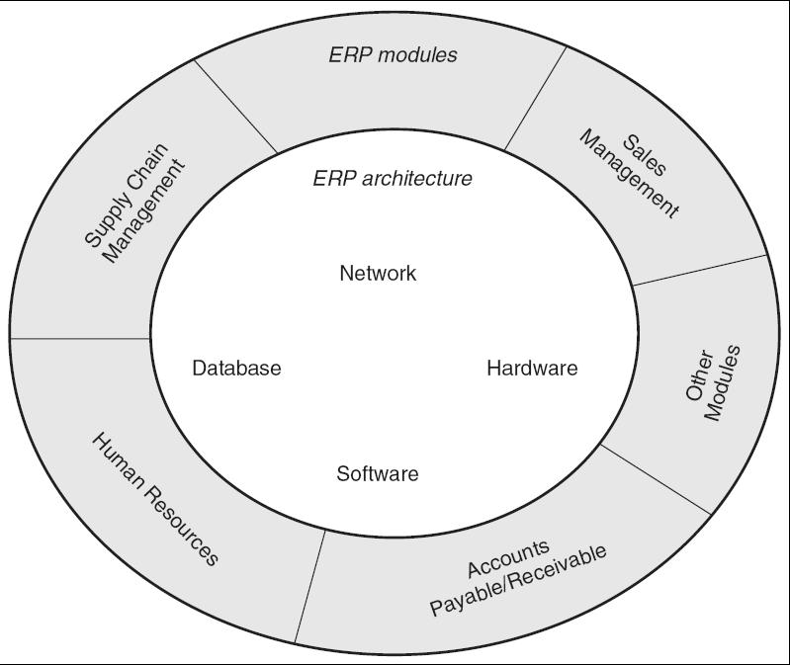
Figure 3-1 Enterprise Systems Architecture (ESA) Model
Copyright © 2012 Pearson Education, Inc. Publishing as Prentice Hall

Slide 4
ERP Modules
The key role of an ERP system is to provide support for such business functions as accounting, sales, inventory control, and production.
ERP vendors, including SAP, Oracle, and Microsoft, etc. provide modules that support the major functional areas of a business.
The ERP software embeds best business practices that implement the organization’s policy and procedure via business rules.
Copyright © 2012 Pearson Education, Inc. Publishing as Prentice Hall

Slide 5
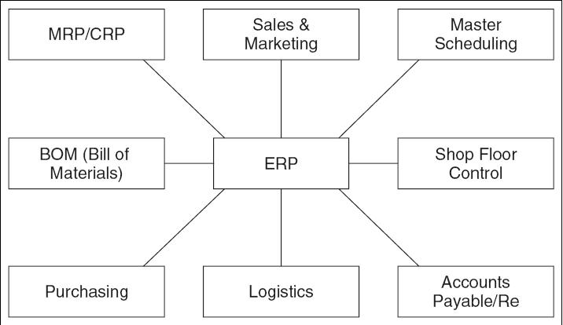
Figure 3-2 Typical ERP Modules
Copyright © 2012 Pearson Education, Inc. Publishing as Prentice Hall

Slide 6
ERP Modules From Three Vendors
Function | SAP | Oracle/ PeopleSoft | Microsoft Dynamics
Sales | Sales and Distribution, Sales Opportunity | Marketing and Sales, Supply Chain Management | Retail POS, Field Service Management
Procurement | Purchasing, Supplier Relationship Management | Procurement and Supplier Relationship Management | Supply Chain Management
Production | MRP, Product Life Cycle Management | Manufacturing | Manufacturing
Accounting | Financial Accounting | Financial Management | Financial Management
Copyright © 2012 Pearson Education, Inc. Publishing as Prentice Hall

Slide 7
ERP Modules From Three Vendors (Cont’d)
Function | SAP | Oracle/ PeopleSoft | Microsoft Dynamics
Distribution | Warehouse Management | Supply Chain Management | Distribution Management
Customer Service | CRM | CRM | CRM
Corporate Performance & Governance | Governance, Risk, and Compliance Management | Corporate Performance Management | Analytics
Human Resources | Human Capital Management | Human Capital Management | HR Management
Miscellaneous | Banking | Campus Solutions | E-commerce, Portals
Copyright © 2012 Pearson Education, Inc. Publishing as Prentice Hall

Slide 8
Overview of Modules
Production
  Helps in the planning and optimizing of the manufacturing capacity, parts, components, and material resources using historical production data and sales forecasting.
Purchasing
  Streamlines the procurement process of required raw materials and other supplies.
Inventory Management
  Facilitates the processes of maintaining the appropriate level of stock in a warehouse.
Copyright © 2012 Pearson Education, Inc. Publishing as Prentice Hall

Slide 9
Overview of Modules (Cont’d)
Sales and Marketing
  Implements functions of order placement, order scheduling, shipping, and invoicing.
Finance
  Can gather financial data from various functional departments and generate valuable financial reports.
Human Resource
  Streamlines the management of human resources and human capitals.
Miscellaneous Modules
  Nontraditional modules such as business intelligence, self-service, project management, and e-commerce.
Copyright © 2012 Pearson Education, Inc. Publishing as Prentice Hall

Slide 10
Benefits of Key ERP Modules
Self Services
  Flexible support for employees’ business functions.
  Simplified access to relevant information.
Performance Management
  Delivery of real-time, personalized measurements and metrics.
  Provides executives with access to such information as business statistics and key performance measurements.
Financials
  Ensure compliance and predictability of business performance.
  Gain deeper financial insight and control across the enterprise.
  Automate accounting and financial SCM.
  Rigorous support for financial reporting—SOX Act.
Copyright © 2012 Pearson Education, Inc. Publishing as Prentice Hall

Slide 11
Benefits of Key ERP Modules (Cont’d)
HR Management
  Attract the right people, develop and leverage talents, align efforts with corporate objectives, and retain top performers.
  Increase efficiency and help ensure compliance with changing global and local regulations by using standardized and automated workforce processes.
  Enable creation of project teams based on skills and availability, monitor progress on projects, track time, and analyze results.
  Manage human capital investments by analyzing business outcomes, workforce trends and demographics, and workforce planning.
Copyright © 2012 Pearson Education, Inc. Publishing as Prentice Hall

Slide 12
Benefits of Key ERP Modules (Cont’d)
Procurement and Logistics Execution
  Sustain cost savings for all spending categories by automating such routine tasks as converting requisitions into purchase orders and by allowing employees to use electronic catalogs to order products and services.
  Reduce costs through process automation, integration of suppliers, and better collaboration.
  Improve resource utilization with support for cross-docking processes and data collection technologies. (RFID and bar codes).
  Enhance productivity of incoming and outgoing physical goods movements.
  Reduce transportation costs through better consolidation and collaboration.
Copyright © 2012 Pearson Education, Inc. Publishing as Prentice Hall

Slide 13
Benefits of Key ERP Modules (Cont’d)
Product Development and Production
  Shorten time to market.
  Deliver higher quality products and ensure timely delivery.
  Real time visibility and transparency (availability check).
Sales and Service
  Higher number of sales orders processed and reduction in administrative costs.
  Easy access to accurate, timely customer information.
  Cost-effective mobile access for field employees.
  Reduce travel costs by using online functions.
  Adhere to environmental, health, and safety reporting requirements.
  Improve the management of incentives and commissions.
  Realize more effective real estate management.
Copyright © 2012 Pearson Education, Inc. Publishing as Prentice Hall

Slide 14
ERP Architecture
ERP system architecture is organized in layers or tiers to manage system complexity in order to provide scalability and flexibility.
Three-layer architecture (the most reliable, flexible, and scalable architecture) is the most prevalent today and includes:
  Web Servers.
  Application Servers.
  Database Servers.
Copyright © 2012 Pearson Education, Inc. Publishing as Prentice Hall

Slide 15
Layered Architecture Example (Info.Net)
The Layered ERP architecture generalizes the functional layers to allow it to change with newer technologies.
A Web-based user interface is provided.
  Users can access the application via the Internet.
  The PC needs to be capable of running a Java-enabled Web browser.
  The PC is connected to both Intranet and Internet to be able to use one of Info.Net’s servers.
  The user interacts with the Java Virtual Machine™ Interface layer to establish a secure connection via a secure socket layer (SSL) connection.
  The user is then communicating with the server through the applications software layer (ASL).
Copyright © 2012 Pearson Education, Inc. Publishing as Prentice Hall

Slide 16
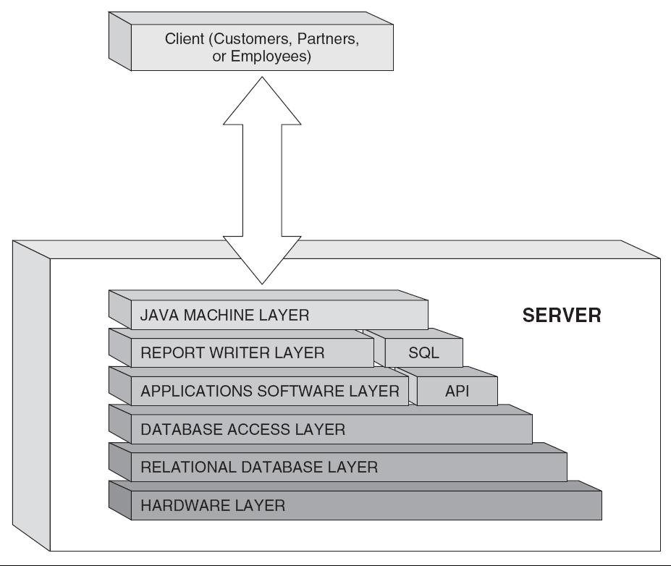
Figure 3-3 Example of Info.Net Architecture
Copyright © 2012 Pearson Education, Inc. Publishing as Prentice Hall

Slide 17
Infrastructure Requirements
Traditional networks require upgrading prior to the deployment of ERP systems and must be a component of the overall budget.
A high-availability network is a requirement for a fully functioning ERP system, one that grows with the user population and supports continued expansion and integration of a supply chain.
Integration with partner and customer systems allows “a company to manage important parts of the business such as order tracking, inventory management etc.”
Online analytical processing (OLAP) provides the ability to access, present, and analyze data across dimensions.
Copyright © 2012 Pearson Education, Inc. Publishing as Prentice Hall

Slide 18
Three-Tier Architecture
Most of the current ERP implementations follow a three-tiered architecture, which consists of a Web tier, an application tier, and a data tier.
Benefits
  Scalability - Easier to add, change, and remove applications.
  Reliability - Implementing multiple levels of redundancy.
  Flexibility - Flexibility in partitioning is very simple.
  Maintainability - Support and maintenance costs are less on one server.
  Reusability - Easier to implement reusable components.
  Security - IT staff has more control system to provide higher security.
Limitations
  Can be very expensive and complex.
Copyright © 2012 Pearson Education, Inc. Publishing as Prentice Hall

Slide 19
Tiers
The Web Tier
  Web-based portal allows users the ability to access and analyze information through their Web browser.
The Application Tier
  Consists of a Web browser and reporting tool where business processes and end-users interact with the system.
  It shields the business users from the inner workings of an ERP system, but still provides the information relevant to their job and business process.
The Data Tier
  Focus is on structure of all organizational data and its relationships with both internal and external systems.
Copyright © 2012 Pearson Education, Inc. Publishing as Prentice Hall

Slide 20
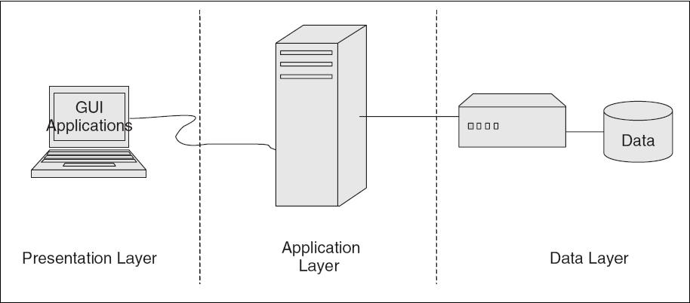
Figure 3-4 A Three-Tier ERP Architecture
Copyright © 2012 Pearson Education, Inc. Publishing as Prentice Hall

Slide 21
Web Services Architectures
Web-based architecture often described as a fourth tier where the Web tier is split into Web Services tier and Web Browser tier.
The ERP systems focus on the Internet to provide a powerful new functionality for Internet-based access and integration.
This functionality is primarily supported through the following Internet access technologies:
  Web Server.
  ERP Portal.
  Back-end Server Integration.
  Browse Plug-ins or Applets.
Copyright © 2012 Pearson Education, Inc. Publishing as Prentice Hall

Slide 22
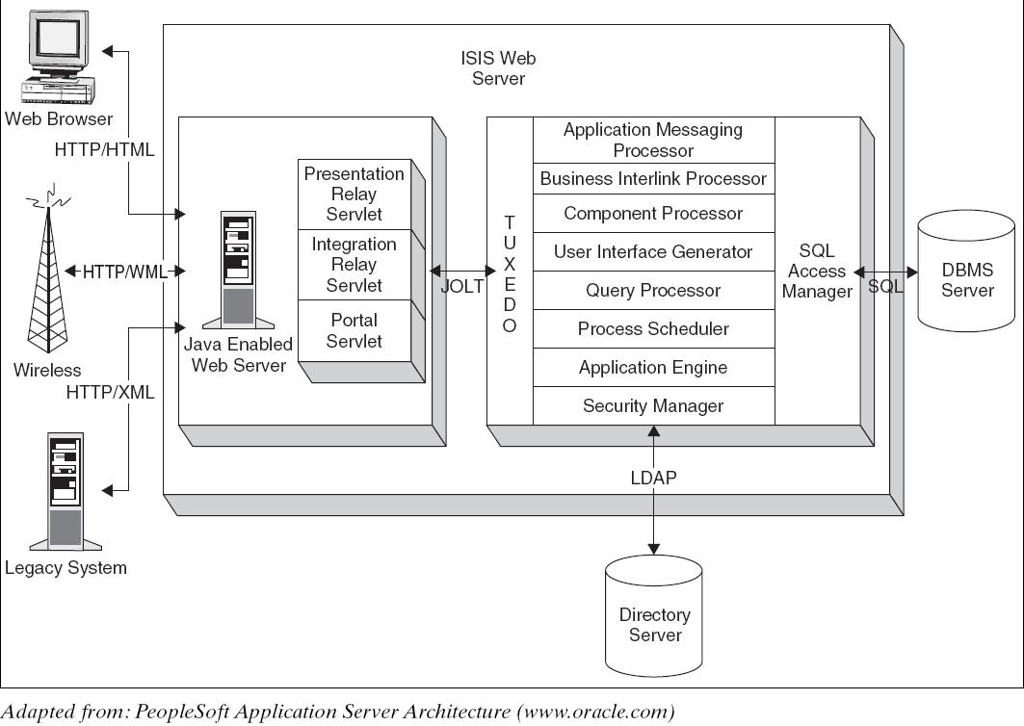
Figure 3-5 Example of PeopleSoft’s Server-Centric Internet Architecture
Copyright © 2012 Pearson Education, Inc. Publishing as Prentice Hall

Slide 23
Benefits and Drawbacks
Benefits
  Large numbers of end-users have access to ERP applications over the Web.
  Easily integrate ERP applications with existing systems.
  Server-centric—No complex, expensive client software installation.
  The server-centric architecture enables secure end-user access to ERP application.
  Client-centric—Architecture has better response time because user requests are mostly processed on the client’s computer.
  Web-based architectures also allow better system-to-system integration.
Drawbacks
  Client-centric architectures lack security.
  Server centric is slower.
Copyright © 2012 Pearson Education, Inc. Publishing as Prentice Hall

Slide 24
Service-Oriented Architectures
Also known as object-oriented architectures for Web platforms.
Breaks the business tier into smaller, distinct units of services, collectively supporting an ERP functional module.
Allows message interaction between any service consumer and service provider.
A consumer from a device using any operating system in any language can use this service.
Copyright © 2012 Pearson Education, Inc. Publishing as Prentice Hall

Slide 25
Service-Oriented Architectures
SOA is a software development model based on a contract between a consumer (client) and a provider (server) that specifies the following:
  Functional description of the service.
  Input requirements and output specifications.
  Precondition environment state before service can be invoked.
  Post condition environment state after service has been executed.
  Error handling when there is a breakdown.
Copyright © 2012 Pearson Education, Inc. Publishing as Prentice Hall

Slide 26
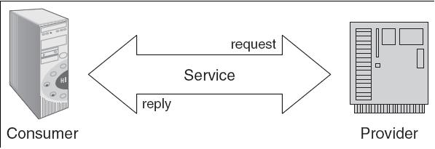
Figure 3-6 A SOA Architecture
Copyright © 2012 Pearson Education, Inc. Publishing as Prentice Hall

Slide 27
Benefits of Service-Oriented Architectures
Business-level software services across heterogeneous platforms.
Complete location independence of business logic.
Services can exist anywhere (any system, any network).
Loose coupling across application services.
Granular authentication and authorization support.
Dynamic search and connectivity to other services.
Enhances reliability of the architecture.
Reduces hardware acquisition costs.
Copyright © 2012 Pearson Education, Inc. Publishing as Prentice Hall

Slide 28
Benefits of Service-Oriented Architectures (Cont’d)
Accelerates movement to standards-based server and application consolidation.
Provides a data bridge between incompatible technologies.
Provides the ability to build composite applications.
Creates a self-healing infrastructure that reduces management costs.
Provides truly real-time decision-making applications.
Enables the compilation of a unified taxonomy of information across an enterprise.
Copyright © 2012 Pearson Education, Inc. Publishing as Prentice Hall

Slide 29
Business Value Benefits of SOA
Increases the ability to meet customer demands more quickly.
Lower costs associated with the acquisition and maintenance of technology.
Empowers the management of business functionality closer to the business units.
Leverages existing investments in technology.
Reduces reliance on expensive custom development.
Copyright © 2012 Pearson Education, Inc. Publishing as Prentice Hall

Slide 30
Drawbacks of Service-Oriented Architectures
SOA implementations are costly and time-consuming.
Requires complex security firewalls in place to support communication between services.
Performance can be inconsistent.
Requires enterprise-level focus for implementation to be successful.
Security system needs to be sophisticated.
Costs can be high because services needs to be junked very often.
Copyright © 2012 Pearson Education, Inc. Publishing as Prentice Hall

Slide 31
SOA and Web Services
Web services basically are interfaces that allow different software application and components to be operated together.
According to IT industry standards, different applications can interact with without communication problems.
The only method of interaction by Web services is by receiving and sending messages.
Services are developed using open standards such as WSDL (Web Services Description Language), UDDI (Universal Description, Discovery, and Integration), and SOAP (Simple Object Access Protocol).
The protocols used in Web services are XML-based.
Copyright © 2012 Pearson Education, Inc. Publishing as Prentice Hall

Slide 32
Enterprise Content Management and SOA
Enterprise content management deals with enterprise software products that usually store, preserve, manage, and deliver content connected to business processes.
Enterprise content management also about supporting business goals, not just managing content.
Vendors have come to an understanding that content management takes advantage of technology and information assets across the business and is no longer application specific.
Copyright © 2012 Pearson Education, Inc. Publishing as Prentice Hall

Slide 33
Cloud Architecture
Cloud computing is basically a software service provided over the Internet, securely, by a service provider on a monthly or yearly lease.
Companies leasing CC services save money by replacing their purchased software that requires a license fee per seat.
Some cloud computing providers also let you build your own applications using their engines and then they would host those applications for you as part of the service.
Copyright © 2012 Pearson Education, Inc. Publishing as Prentice Hall

Slide 34
Cloud Architecture
The cloud computing platform provides a great alternative for organizations that do not want to:
  Purchase, install, or maintain software applications.
  Worry about security, privacy and legal issues associated with data storage.
The cloud computing platform is risky for organizations as it forces them to rely on external vendors for reliability, security, and continuity of enterprise applications.
Copyright © 2012 Pearson Education, Inc. Publishing as Prentice Hall

Slide 35
Benefits of Cloud Computing
Pay for subscription, not for licenses and upgrades.
Reduced capital and operating expenditures for IT equipment and support personnel.
Accessed from everywhere, as long as you have an Internet connection.
No need to install anything on the user’s computer.
Dynamic scalability available on demand.
No maintenance fees for software or hardware.
Promotes green computing environment as servers in cloud run on clean energy.
Guaranteed reliability.
Copyright © 2012 Pearson Education, Inc. Publishing as Prentice Hall

Slide 36
Drawbacks of Cloud Computing
Data security.
Vulnerability.
Possible conflict of interest, if the company who stores your applications decides to create a similar application to what you created on their servers.
Not suited for all highly competitive industries like biotech where intellectual property cannot be protected easily.
Copyright © 2012 Pearson Education, Inc. Publishing as Prentice Hall

Slide 37
Implications for Management
Enterprise architecture is an important technology for the long-term functioning of the organization.
ERP architecture decisions are complex because their impact goes beyond systems and technology to people, organizational policy, and business processes.
ERP architecture must be flexible to support a diverse set of hardware and software platforms.
Management must learn how to filter out the hyped technologies that do not provide value to their organization.
Copyright © 2012 Pearson Education, Inc. Publishing as Prentice Hall

